Slide 1
Attention

Slide 2
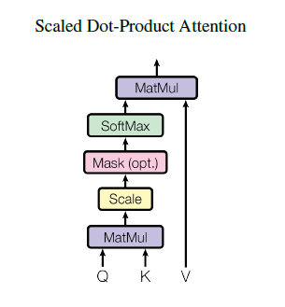


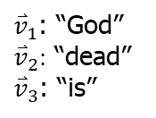
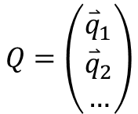
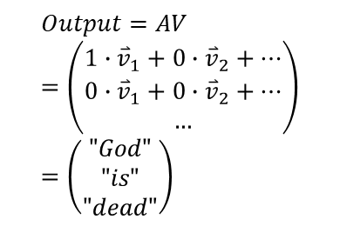
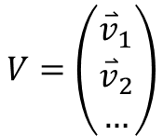
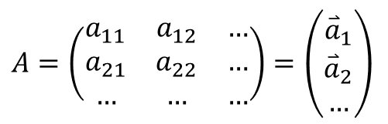
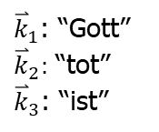

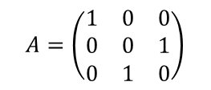

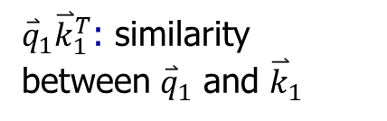

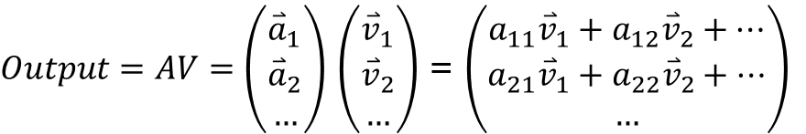
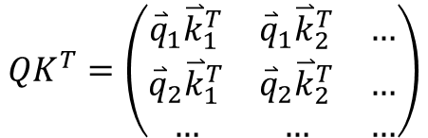
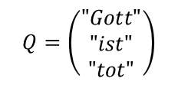
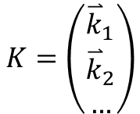
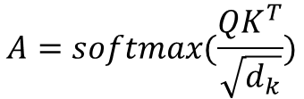
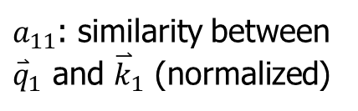
Attention
Q: a set of query vectors
K: a set of key vectors
V: a set of value vectors
n: document length
dk: embedding length
dv: output length
Use the similarity between q and k to determine the coefficient of value vectors.
$$Q=\left(\begin{matrix}{\overset{⃑}{q}}_{1} \\ {\overset{⃑}{q}}_{2} \\ …\end{matrix}\right)$$
$$K=\left(\begin{matrix}{\overset{⃑}{k}}_{1} \\ {\overset{⃑}{k}}_{2} \\ …\end{matrix}\right)$$
$$V=\left(\begin{matrix}{\overset{⃑}{v}}_{1} \\ {\overset{⃑}{v}}_{2} \\ …\end{matrix}\right)$$
e.g.:
{K,V} is a German-English dictionary.
$$n×d_{k}$$
$$N×d_{k}$$
$$N×d_{v}$$
${\overset{⃑}{k}}_{1}$: “Gott”
${\overset{⃑}{k}}_{2}:$ “tot”
${\overset{⃑}{k}}_{3}$: “ist”
${\overset{⃑}{v}}_{1}$: “God”
${\overset{⃑}{v}}_{2}:$ “dead”
${\overset{⃑}{v}}_{3}$: “is”
$$A=softmax(\frac{QK^{T}}{\sqrt{d_{k}}})$$
$$QK^{T}=\left(\begin{matrix}{\overset{⃑}{q}}_{1}{\overset{⃑}{k}}_{1}^{T} & {\overset{⃑}{q}}_{1}{\overset{⃑}{k}}_{2}^{T} & … \\ {\overset{⃑}{q}}_{2}{\overset{⃑}{k}}_{1}^{T} & {\overset{⃑}{q}}_{2}{\overset{⃑}{k}}_{2}^{T} & … \\ … & … & …\end{matrix}\right)$$
${\overset{⃑}{q}}_{1}{\overset{⃑}{k}}_{1}^{T}$: similarity between ${\overset{⃑}{q}}_{1}$ and ${\overset{⃑}{k}}_{1}$
$$Q=\left(\begin{matrix}"Gott" \\ "ist" \\ "tot"\end{matrix}\right)$$
$$A=\left(\begin{matrix}1 & 0 & 0 \\ 0 & 0 & 1 \\ 0 & 1 & 0\end{matrix}\right)$$
$A=\left(\begin{matrix}a_{11} & a_{12} & … \\ a_{21} & a_{22} & … \\ … & … & …\end{matrix}\right)=$ $\left(\begin{matrix}{\overset{⃑}{a}}_{1} \\ {\overset{⃑}{a}}_{2} \\ …\end{matrix}\right)$
$a_{11}$: similarity between ${\overset{⃑}{q}}_{1}$ and ${\overset{⃑}{k}}_{1}$ (normalized)
$$n×n$$
$$Output=AV=\left(\begin{matrix}{1∙\overset{⃑}{v}}_{1}+{0∙\overset{⃑}{v}}_{2}+… \\ {0∙\overset{⃑}{v}}_{1}+{0∙\overset{⃑}{v}}_{2}+… \\ …\end{matrix}\right)=\left(\begin{matrix}"God" \\ "is" \\ "dead"\end{matrix}\right)$$
$Output=AV=\left(\begin{matrix}{\overset{⃑}{a}}_{1} \\ {\overset{⃑}{a}}_{2} \\ …\end{matrix}\right)$ $\left(\begin{matrix}{\overset{⃑}{v}}_{1} \\ {\overset{⃑}{v}}_{2} \\ …\end{matrix}\right)$ = $\left(\begin{matrix}{a_{11}\overset{⃑}{v}}_{1}+{a_{12}\overset{⃑}{v}}_{2}+… \\ {a_{21}\overset{⃑}{v}}_{1}+{a_{22}\overset{⃑}{v}}_{2}+… \\ …\end{matrix}\right)$
$$n×d_{v}$$

Slide 3
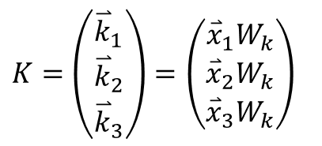


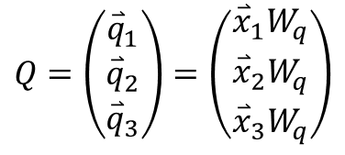
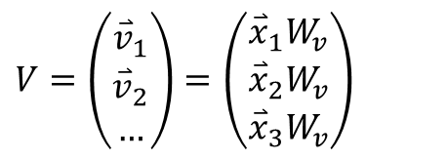


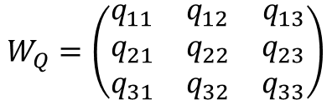
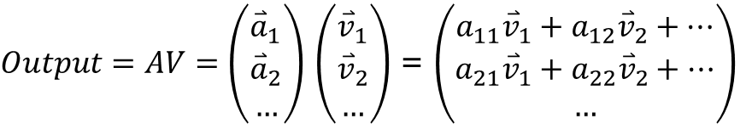
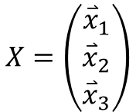

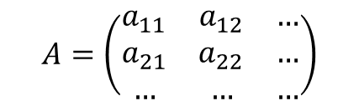

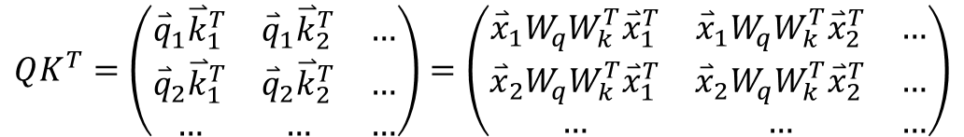

Self-attention
X: a set of embedding vectors
Q: Query matrix
K: a set of key vectors
V: a set of value vectors
$$QK^{T}=\left(\begin{matrix}{\overset{⃑}{q}}_{1}{\overset{⃑}{k}}_{1}^{T} & {\overset{⃑}{q}}_{1}{\overset{⃑}{k}}_{2}^{T} & … \\ {\overset{⃑}{q}}_{2}{\overset{⃑}{k}}_{1}^{T} & {\overset{⃑}{q}}_{2}{\overset{⃑}{k}}_{2}^{T} & … \\ … & … & …\end{matrix}\right)=\left(\begin{matrix}{\overset{⃑}{x}}_{1}W_{q}W_{k}^{T}{\overset{⃑}{x}}_{1}^{T} & {\overset{⃑}{x}}_{1}W_{q}W_{k}^{T}{\overset{⃑}{x}}_{2}^{T} & … \\ {\overset{⃑}{x}}_{2}W_{q}W_{k}^{T}{\overset{⃑}{x}}_{1}^{T} & {\overset{⃑}{x}}_{2}W_{q}W_{k}^{T}{\overset{⃑}{x}}_{2}^{T} & … \\ … & … & …\end{matrix}\right)$$
$$A=\left(\begin{matrix}a_{11} & a_{12} & … \\ a_{21} & a_{22} & … \\ … & … & …\end{matrix}\right)$$
$V=\left(\begin{matrix}{\overset{⃑}{v}}_{1} \\ {\overset{⃑}{v}}_{2} \\ …\end{matrix}\right)=$ $\left(\begin{matrix}{\overset{⃑}{x}}_{1}W_{v} \\ {\overset{⃑}{x}}_{2}W_{v} \\ {\overset{⃑}{x}}_{3}W_{v}\end{matrix}\right)$
$$Q=XW_{Q}$$
$$K=XW_{K}$$
$$V=XW_{V}$$
$$X=\left(\begin{matrix}{\overset{⃑}{x}}_{1} \\ {\overset{⃑}{x}}_{2} \\ {\overset{⃑}{x}}_{3}\end{matrix}\right)$$
$$W_{Q}=\left(\begin{matrix}q_{11} & q_{12} & q_{13} \\ q_{21} & q_{22} & q_{23} \\ q_{31} & q_{32} & q_{33}\end{matrix}\right)$$
$Output=AV=\left(\begin{matrix}{\overset{⃑}{a}}_{1} \\ {\overset{⃑}{a}}_{2} \\ …\end{matrix}\right)$ $\left(\begin{matrix}{\overset{⃑}{v}}_{1} \\ {\overset{⃑}{v}}_{2} \\ …\end{matrix}\right)$ = $\left(\begin{matrix}{a_{11}\overset{⃑}{v}}_{1}+{a_{12}\overset{⃑}{v}}_{2}+… \\ {a_{21}\overset{⃑}{v}}_{1}+{a_{22}\overset{⃑}{v}}_{2}+… \\ …\end{matrix}\right)$
$$d_{model}×d_{q}$$
$$Q=\left(\begin{matrix}{\overset{⃑}{q}}_{1} \\ {\overset{⃑}{q}}_{2} \\ {\overset{⃑}{q}}_{3}\end{matrix}\right)=\left(\begin{matrix}{\overset{⃑}{x}}_{1}W_{q} \\ {\overset{⃑}{x}}_{2}W_{q} \\ {\overset{⃑}{x}}_{3}W_{q}\end{matrix}\right)$$
$$W_{K}$$
$$d_{model}×d_{k}$$
$$d_{q}=d_{k}$$
$K=\left(\begin{matrix}{\overset{⃑}{k}}_{1} \\ {\overset{⃑}{k}}_{2} \\ {\overset{⃑}{k}}_{3}\end{matrix}\right)=$ $\left(\begin{matrix}{\overset{⃑}{x}}_{1}W_{k} \\ {\overset{⃑}{x}}_{2}W_{k} \\ {\overset{⃑}{x}}_{3}W_{k}\end{matrix}\right)$
What if Q, K are not computed separately?
Instead, define a new matrix Wqk (n*n) to calculate A.

Slide 4
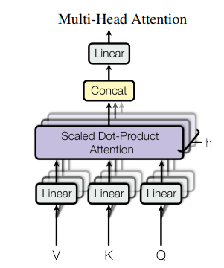

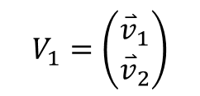
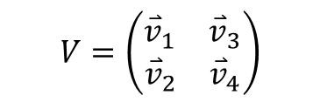


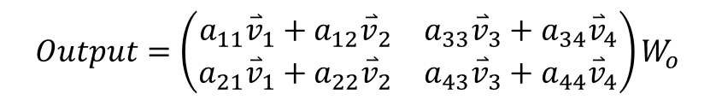

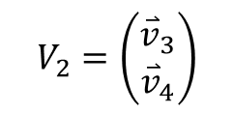





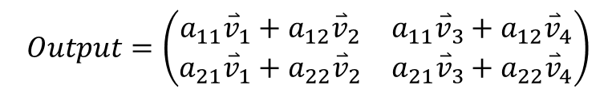



Multi-head self-attention
$$Q_{1}$$
$$K_{1}$$
$$V_{1}$$
$${Output}_{1}$$
${[Output}_{1}$ ${Output}_{2}]$
$$Q_{2}$$
$$K_{2}$$
$$V_{2}$$
$${Output}_{2}$$
$$A_{1}=\left(\begin{matrix}a_{11} & a_{12} \\ a_{21} & a_{22}\end{matrix}\right)$$
$$V_{1}=\left(\begin{matrix}{\overset{⃑}{v}}_{1} \\ {\overset{⃑}{v}}_{2}\end{matrix}\right)$$
$$A_{2}=\left(\begin{matrix}a_{33} & a_{34} \\ a_{43} & a_{44}\end{matrix}\right)$$
$$V_{2}=\left(\begin{matrix}{\overset{⃑}{v}}_{3} \\ {\overset{⃑}{v}}_{4}\end{matrix}\right)$$
$$Output=\left(\begin{matrix}{a_{11}\overset{⃑}{v}}_{1}+{a_{12}\overset{⃑}{v}}_{2} & {a_{33}\overset{⃑}{v}}_{3}+{a_{34}\overset{⃑}{v}}_{4} \\ {a_{21}\overset{⃑}{v}}_{1}+{a_{22}\overset{⃑}{v}}_{2} & {a_{43}\overset{⃑}{v}}_{3}+{a_{44}\overset{⃑}{v}}_{4}\end{matrix}\right)W_{o}$$
$$A=\left(\begin{matrix}a_{11} & a_{12} \\ a_{21} & a_{22}\end{matrix}\right)$$
$$V=\left(\begin{matrix}\begin{matrix}{\overset{⃑}{v}}_{1} & {\overset{⃑}{v}}_{3}\end{matrix} \\ \begin{matrix}{\overset{⃑}{v}}_{2} & {\overset{⃑}{v}}_{4}\end{matrix}\end{matrix}\right)$$
Different representation subspace at different positions
Single head
$$Output=\left(\begin{matrix}{a_{11}\overset{⃑}{v}}_{1}+{a_{12}\overset{⃑}{v}}_{2} & {a_{11}\overset{⃑}{v}}_{3}+{a_{12}\overset{⃑}{v}}_{4} \\ {a_{21}\overset{⃑}{v}}_{1}+{a_{22}\overset{⃑}{v}}_{2} & {a_{21}\overset{⃑}{v}}_{3}+{a_{22}\overset{⃑}{v}}_{4}\end{matrix}\right)$$

Slide 5
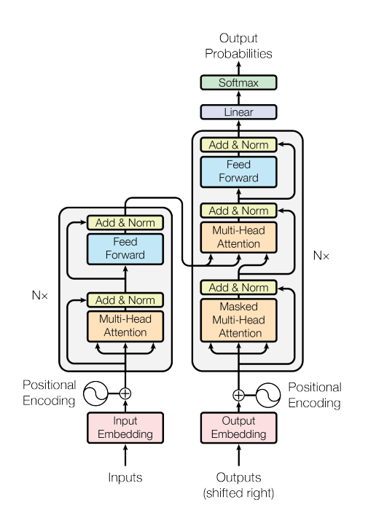
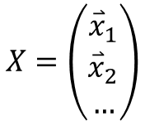

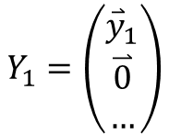

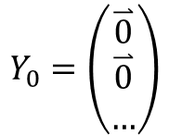
Transformer
$${\overset{⃑}{y}}_{1}$$
$${\overset{⃑}{y}}_{2}$$
Input X and Y0.
Compute y1.
Input Y1.
Compute y2.
…
$$X=\left(\begin{matrix}{\overset{⃑}{x}}_{1} \\ {\overset{⃑}{x}}_{2} \\ …\end{matrix}\right)$$
$$Y_{0}=\left(\begin{matrix}\overset{⃑}{0} \\ \overset{⃑}{0} \\ …\end{matrix}\right)$$
$$Y_{1}=\left(\begin{matrix}{\overset{⃑}{y}}_{1} \\ \overset{⃑}{0} \\ …\end{matrix}\right)$$

Slide 6
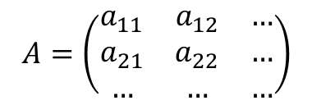
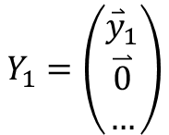
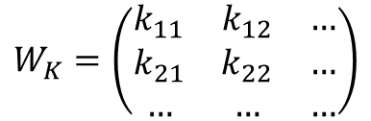

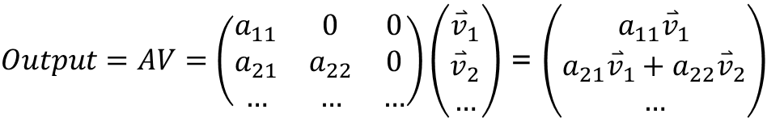
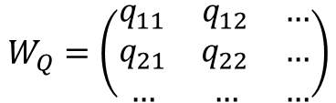
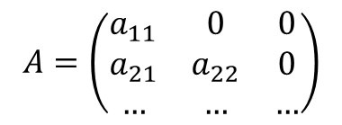


Masked Self-attention
Masked self-attention
Input:
$$Y_{1}=\left(\begin{matrix}{\overset{⃑}{y}}_{1} \\ \overset{⃑}{0} \\ …\end{matrix}\right)$$
$$Q=YW_{Q}$$
$$K=YW_{K}$$
$$W_{Q}=\left(\begin{matrix}q_{11} & q_{12} & … \\ q_{21} & q_{22} & … \\ … & … & …\end{matrix}\right)$$
$$W_{K}=\left(\begin{matrix}k_{11} & k_{12} & … \\ k_{21} & k_{22} & … \\ … & … & …\end{matrix}\right)$$
$$A=\left(\begin{matrix}a_{11} & a_{12} & … \\ a_{21} & a_{22} & … \\ … & … & …\end{matrix}\right)$$
Set
$$a_{ij}=0, for all i<j, e.g., a_{12}$$
$$A=\left(\begin{matrix}a_{11} & 0 & 0 \\ a_{21} & a_{22} & 0 \\ … & … & …\end{matrix}\right)$$
$Output=AV=\left(\begin{matrix}a_{11} & 0 & 0 \\ a_{21} & a_{22} & 0 \\ … & … & …\end{matrix}\right)\left(\begin{matrix}{\overset{⃑}{v}}_{1} \\ {\overset{⃑}{v}}_{2} \\ …\end{matrix}\right)$ = $\left(\begin{matrix}{a_{11}\overset{⃑}{v}}_{1} \\ {a_{21}\overset{⃑}{v}}_{1}+{a_{22}\overset{⃑}{v}}_{2} \\ …\end{matrix}\right)$

